Slide 1

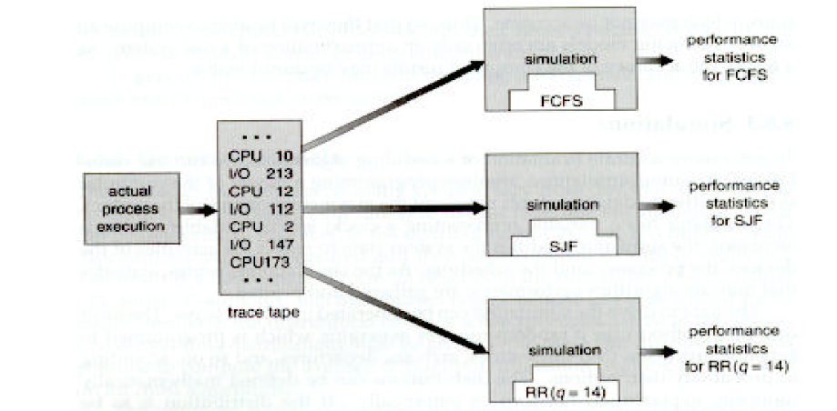
Lecture 3
CPU Scheduling
Basic Concepts, Scheduling Algorithms, Case Studies
Borko Furht
Florida Atlantic University

Slide 2
Schedulers
Long-term scheduling (Job scheduler)
Medium-term scheduling
Short-term scheduling (CPU scheduler)

Slide 3
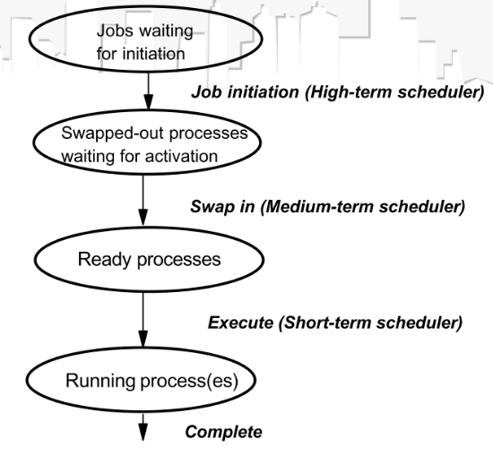
Scheduling Levels

Slide 4
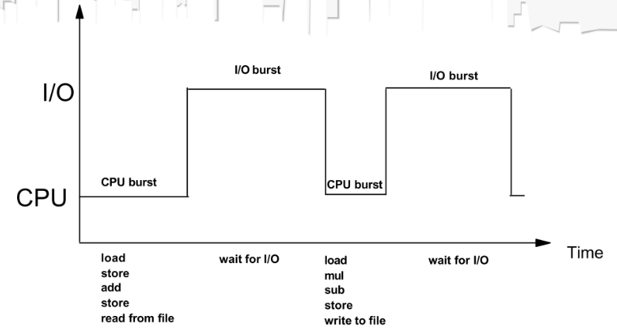
CPU and I/O Bursts

Slide 5
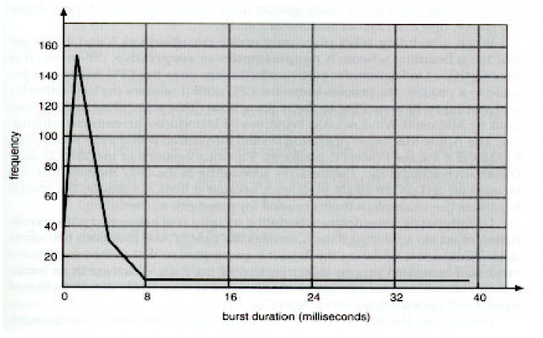
Histogram of CPU-burst Times

Slide 6
I/O – and CPU-Bound Programs
Large number of short CPU bursts, and a small number of long CPU bursts.
I/O-bound program has many very short CPU bursts.
CPU-bound program has a few very long CPU bursts.
This distribution is import for selection of an appropriate scheduling algorithm.

Slide 7
Scheduling Objectives
Be fair – all processes should be treated the same. Otherwise, indefinite postponement for some processes.
Maximize throughput
Balance resources use – keep the system resources busy
Minimize overhead
Enforce priorities – if they exist

Slide 8
Scheduling Criteria For Selecting Algorithms
CPU utilization – ranges from 0-100%. In a real system from 40% (lightly loaded systems) to 90% (heavily used systems)
Throughput – the number of processes completed per time unit. Examples: 1 process/hour or 10 processes/second.
Turnaround time – the interval from the time of submission to the time of a process completion.
Waiting time – the sum of periods a process spent waiting in the ready queue.
Response time – the time from the submission of a request until the first response is produced .
GOAL: maximize CPU utilization and throughput and minimize turnaround time, waiting time, and response time.

Slide 9
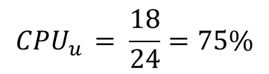
CPU Utilization
P 1
P 2
P 3
P 1
0 3 5 10 12 14 18 24
$$CPU_{u }= \frac{18}{24}=75\%$$

Slide 10
Preemptive Versus Non-preemptive Scheduling
Non-preemptive scheduling- a process has to be given the CPU, which cannot be taken from the process before its completion or switching to the Wait state.
Problem: short jobs may wait doe long jobs. Response time is not predictable.
Preemptive scheduling – the CPU can be taken away from the running process before its completion.
Cost of preemptive scheduling – context switching between process and the coordination between them

Slide 11
Dispatcher
Dispatcher is a module of the OS activated after the CPU scheduler has selected the next running process.
It is invoked during every process switch, and should be as fast as possible.
The dispatcher performs: (a) switching context from one to another process, (b) switching to user mode, and (c) jump to proper location in the user program and restart it.
Dispatch latency – the time takes for the dispatcher to stop one process and start another one.

Slide 12
Scheduling Algorithms
First-Come, First-Served (FCFS) scheduling
Shortest-Job-First (SJF) scheduling
Priority scheduling
Round-Robin (RR) scheduling
Multilevel Queue scheduling
Multilevel Feedback Queue scheduling

Slide 13
First-Come, First-Served Scheduling
The processes are dispatched according to their arrival times.
Simple implementation with a FIFO queue.
FCFS is non-preemptive scheduling – short (important) jobs can wait ling.
Average wait time is quite long.
Rarely used; but can be used as an additional technique. Example: in priority scheduling for the process of the same priority .

Slide 14
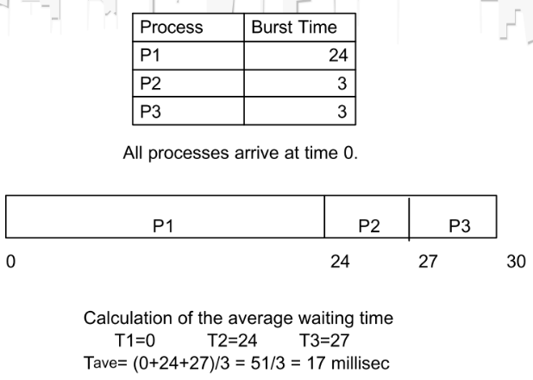
Average Waiting Time Calculation for the FCFS Scheduler

Slide 15
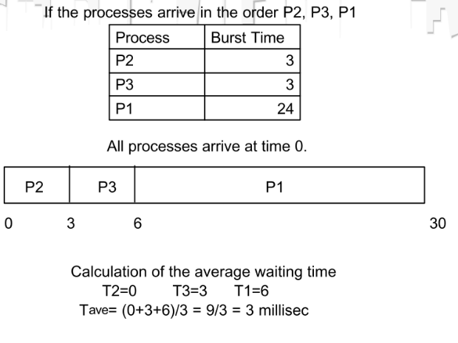
Average Waiting Time Calculation for the FCFS Scheduler

Slide 16
Shortest-Job-First Scheduling
The CPU is assigned to the process that has the shortest next CPU burst.
FCFS is used to break the tie, if two processes have the same next CPU burst.
SJF is optimal – gives the minimum average waiting time for a given set of processes.
Difficulty: SJF requires the length of the next CPU request.
For long-term (job) scheduling in a batch system, we can use the length of the process time limit that users specify.
For short-term (CPU) scheduling, there is no way to know the length of the next CPU burst.

Slide 17
Approximate SJF Scheduling
Predict the next CPU burst – the next CPU burst will be similar in length to the previous ones.
The next CPU burst is predicted as an exponential average of the measured lengths of previous CPU bursts.
The scheduler selects the process with the shortest predicted CPU burst.

Slide 18
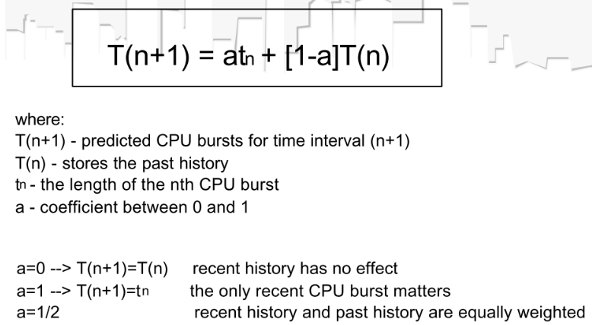
Prediction Function

Slide 19
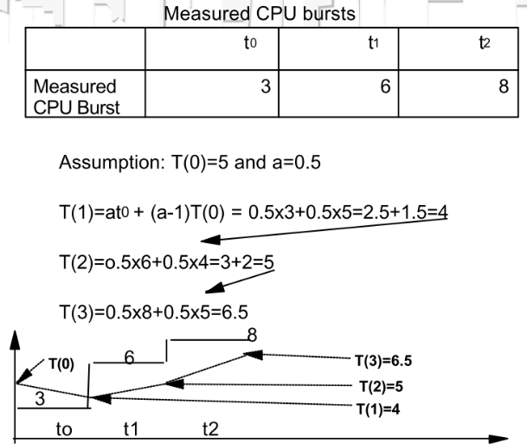
Prediction of the Length of the Next CPU Burst

Slide 20
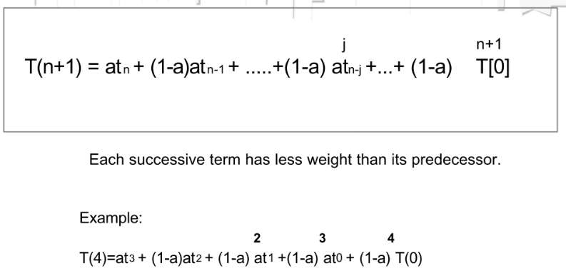
Expanded Formula For T(n+1)

Slide 21
Preemptive and Non-Preemptive SJF
When a new process arrives at the ready queue – the new process may have a shorter next CPU burst than what is left of the currently executing process.
Preemptive SJF will preempt the currently executing process.
Non-preemptive SJF will allow the currently running process to finish its CPU burst.
Preemptive SJF is also called Shortest-remaining-time-first scheduling

Slide 22
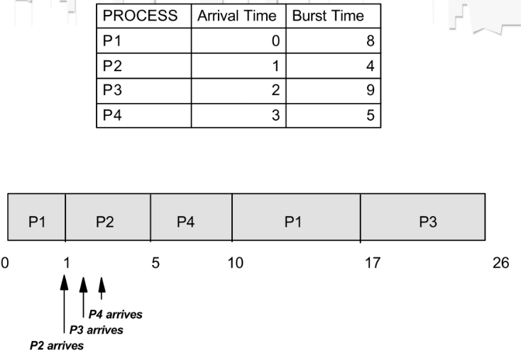
Example of Preemptive SJF Scheduling

Slide 23
Priority Scheduling
Every process has its priority, and the CPU is allocated to the process with the highest priority.
Processes with the same priorities are scheduled in FCFS order.
AN SJF algorithm us a priority algorithm where the priority (p) is the inverse of the (predicted) next CPU burst. Larger CPU burst – lower priority.

Slide 24
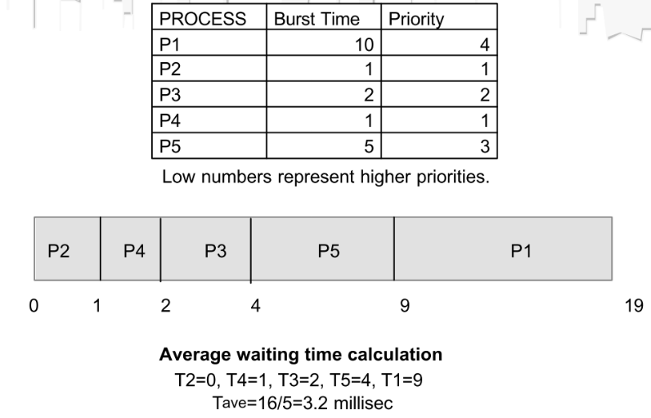
Example of Priority Scheduling

Slide 25
Priorities
Can be defined internally or externally
Internally defined priorities – use some measurable quantities to compute priorities
Example include: time limits, memory requirements, the number of open files, the ratio of average I/O burst to average CPU burst.
External priorities – importance of the process, funds paid for using computer, etc.

Slide 26
Preemptive and Non-Preemptive Priority Scheduling
Preemptive priority scheduler will preempt the CPU of the priority of the newly arrived process is higher than the priority of the running process.
The non-preemptive scheduler will put the new process at the head of the ready queue.

Slide 27
Indefinite Blocking (Starvation)
Major problem with priority scheduling.
In heavy-loaded systems, some low-priority processes can be indefinitely waiting for the CPU.
Solution: aging technique
Aging technique: gradually increasing the priority of processes that wait in the system for a long time.

Slide 28
Example of Aging Technique
Priorities in a system: 0 (low) to 127 (high)
Aging: increment the priorities of waiting processes by 1 every 15 minutes.
It will take 32 hours (128x15 minutes) for a lowest priority process (0 priority) to age to the highest priority 127.

Slide 29
Round-Robin (RR) Scheduling
Specially designed for time-sharing systems.
Similar to FCFS, but preemption is added to switch between processes
Time quantum (or slice) is defined. T=10-100 milliseconds.
Ready queue is treated as a circular queue.
Implementation – FIFO queue, where new processes are added to the tail of the ready queue.
The timer interrupts after 1 time quantum, and the scheduler dispatches the first process from the ready queue.

Slide 30
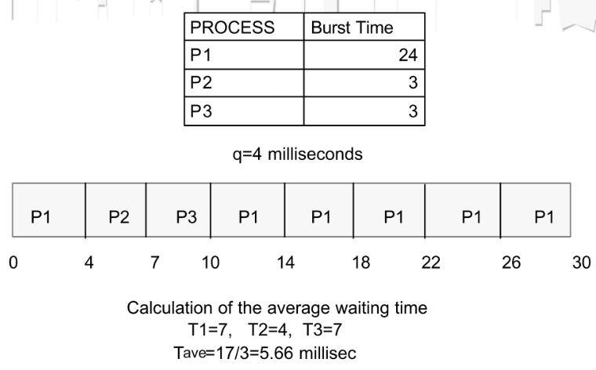
Example of Round-Robin Scheduling

Slide 31
Performance of RR Scheduling
If there are n processes and the time quantum is q → each process gets 1/n of the CPU time.
Maximum waiting time for the next quantum is Twait=(n-1)xq.
Example: for n=5 processes and q=20 milliseconds, every 100 milliseconds.
Twait = 4x20=80 milliseconds.

Slide 32
Size of the Time Quantum
The performance of the RR algorithm depends of the size of the time quantum.
If q is very large, the RR algorithm is the same as FCFS.
If q is very small (say 1 millisecond), the RR algorithm is called processor sharing.
Smaller time quantum – more context switches.
Rule of thumb – 80% of the CPU bursts should be shorter than the time quantum.

Slide 33
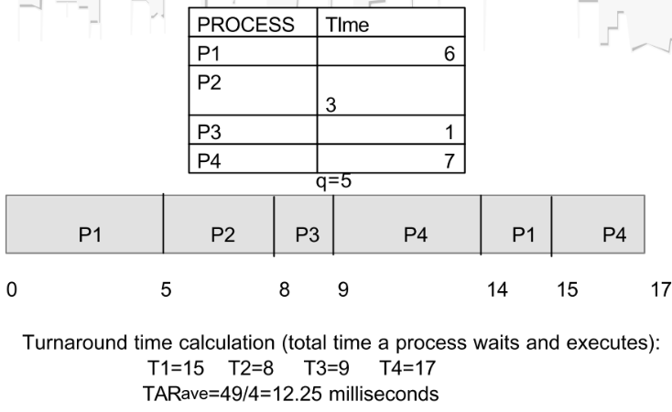
Turnaround Time and Time Quantum in RR Scheduling
3

Slide 34
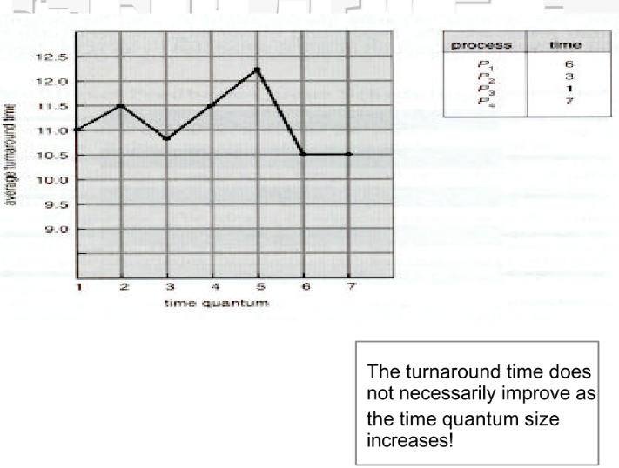
Turnaround Time Versus Time Quantum

Slide 35
Multilevel Queue Scheduling
Processes are classified into different groups.
Example: foreground (interactive) processes and background (batch) processes
They have different response time requirements.
Each queue has its own scheduling algorithm.
Example: the foreground queue uses RR algorithm, while the background queue is scheduled by an FCFS algorithm.
Scheduling between queues - usually fixed-priority preemptive scheduling.

Slide 36
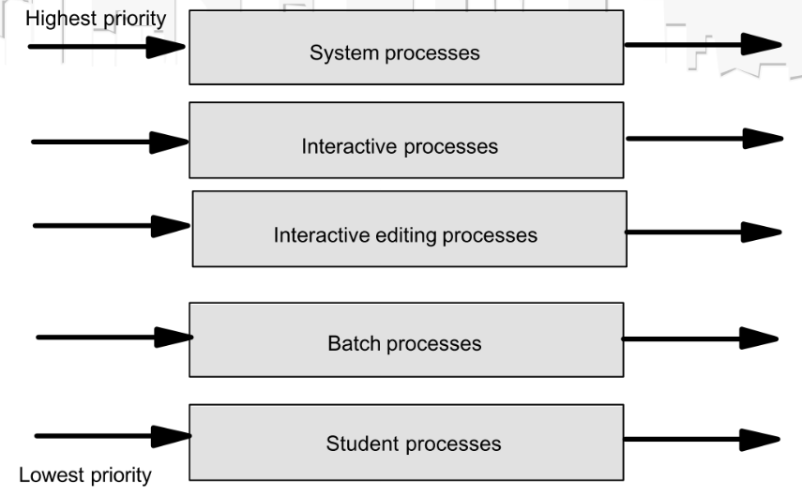
Example of Multilevel Queue Scheduling

Slide 37
Multilevel Queues – Two Schemes
(a) Each queue has absolute priority over lower priority queues.
(b) Time slice between the queues - each queue gets a certain portion of the CPU time, which it can schedule among the processes in its queue.
Example: The foreground queue can be given 80% of the CPU time for RR scheduling, while background queue receives 20% of the CPU for its processes scheduled using FCFS algorithm.

Slide 38
Multilevel Feedback Queue (MFQ) Scheduling
In a multilevel queue scheduling, processes are permanently assigned to a queue and do not move between queues.
This scheme is inflexible!
Multilevel feedback queue scheduling allows a process to move between queues.
If a process uses too much CPU time, it will be moved to a lower priority queue.
I/O bound and interactive processes stay in higher priority queues.
Processes waiting too long in low priority queues will be moved to higher priority queues.

Slide 39
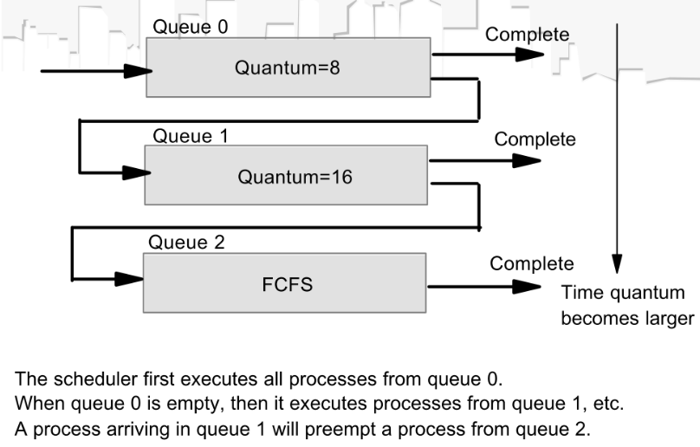
Multilevel Feedback Queues

Slide 40
Parameters of the MFQ Scheduler
Number of queues
Scheduling algorithm for each queue
Method used to determine when to upgrade a process to a higher priority queue
Method used to determine when to demote a process to a lower priority queue
Method to determine an initial queue for a new process.
The most complex scheduling scheme!

Slide 41
Evaluation of Scheduling Algorithms
Define the criteria for the evaluation. Examples: CPU utilization, Response time, or Throughput
Several measures can be specified. Example 1: maximize CPU utilization under the constraint that the maximum response time is 1 second
Example 2: Maximize throughput such that turnaround time is linearly proportional to total execution time.
Deterministic modeling
Queuing models
Simulations

Slide 42
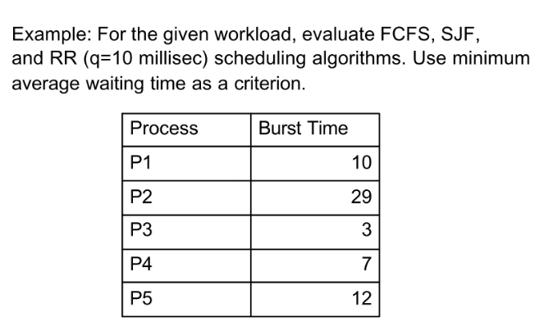
Deterministic Modeling
Analytic evaluation. For a predetermined workload calculates the performance for each algorithm.

Slide 43
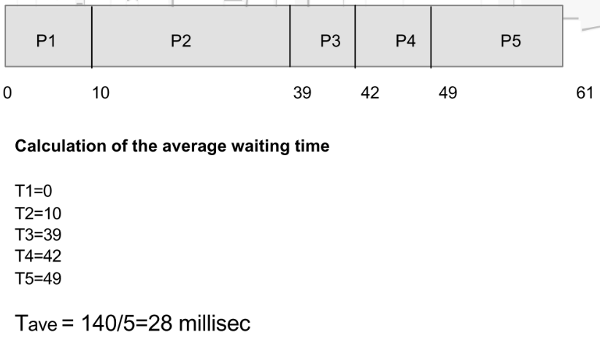
Evaluation – FCFS Algorithm

Slide 44
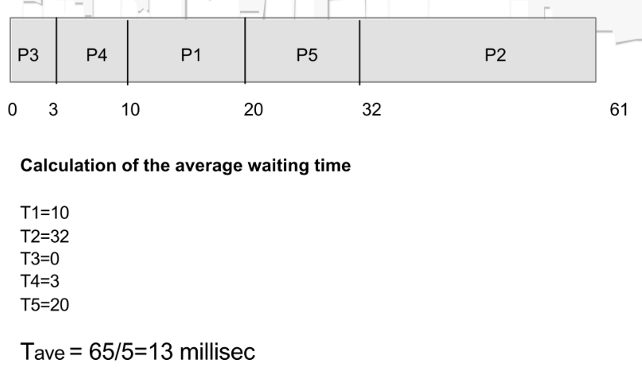
Evaluation – Non-Preemptive SJF Algorithm

Slide 45
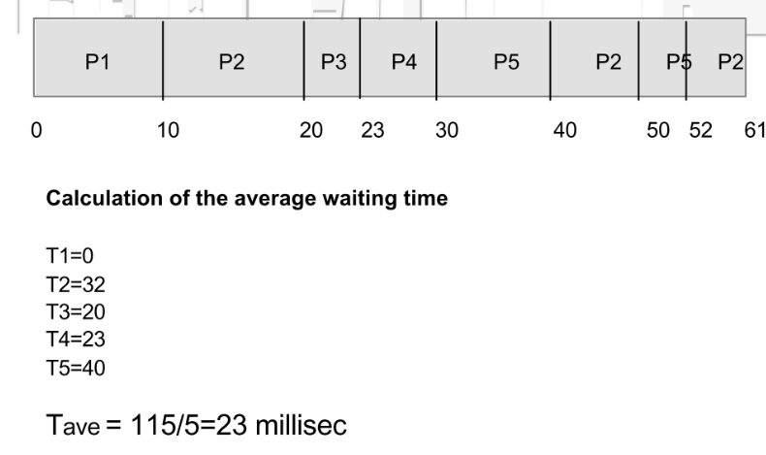
Evaluation – RR Algorithm

Slide 46
Features of Deterministic Modeling
Requires too much exact knowledge.
It is simple and fast.
The main uses is to describe scheduling algorithms and provide examples.
In the case when we run the same program many times, the process burst times can be measured, and deterministic modeling can be applied.

Slide 47
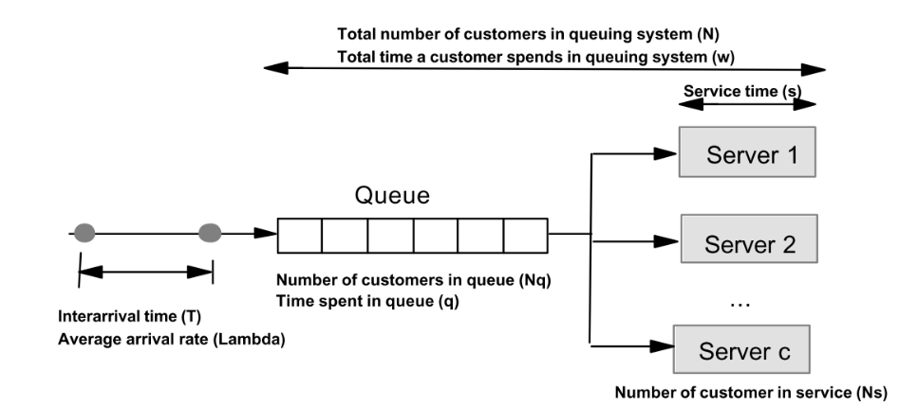
Queuing Models
Mathematical representation of a system using queuing theory.
The computer system is described as a network of servers.
Each server has a queue of waiting processes (reedy queue, I/O device queues)

Slide 48
Simulations More accurate evaluation of scheduling algorithms

Slide 49
Programming Project
Tell me and I will forget, show me and I will remember, engage me and I will understand. Confucius (551-479 BC)

